Slide 1
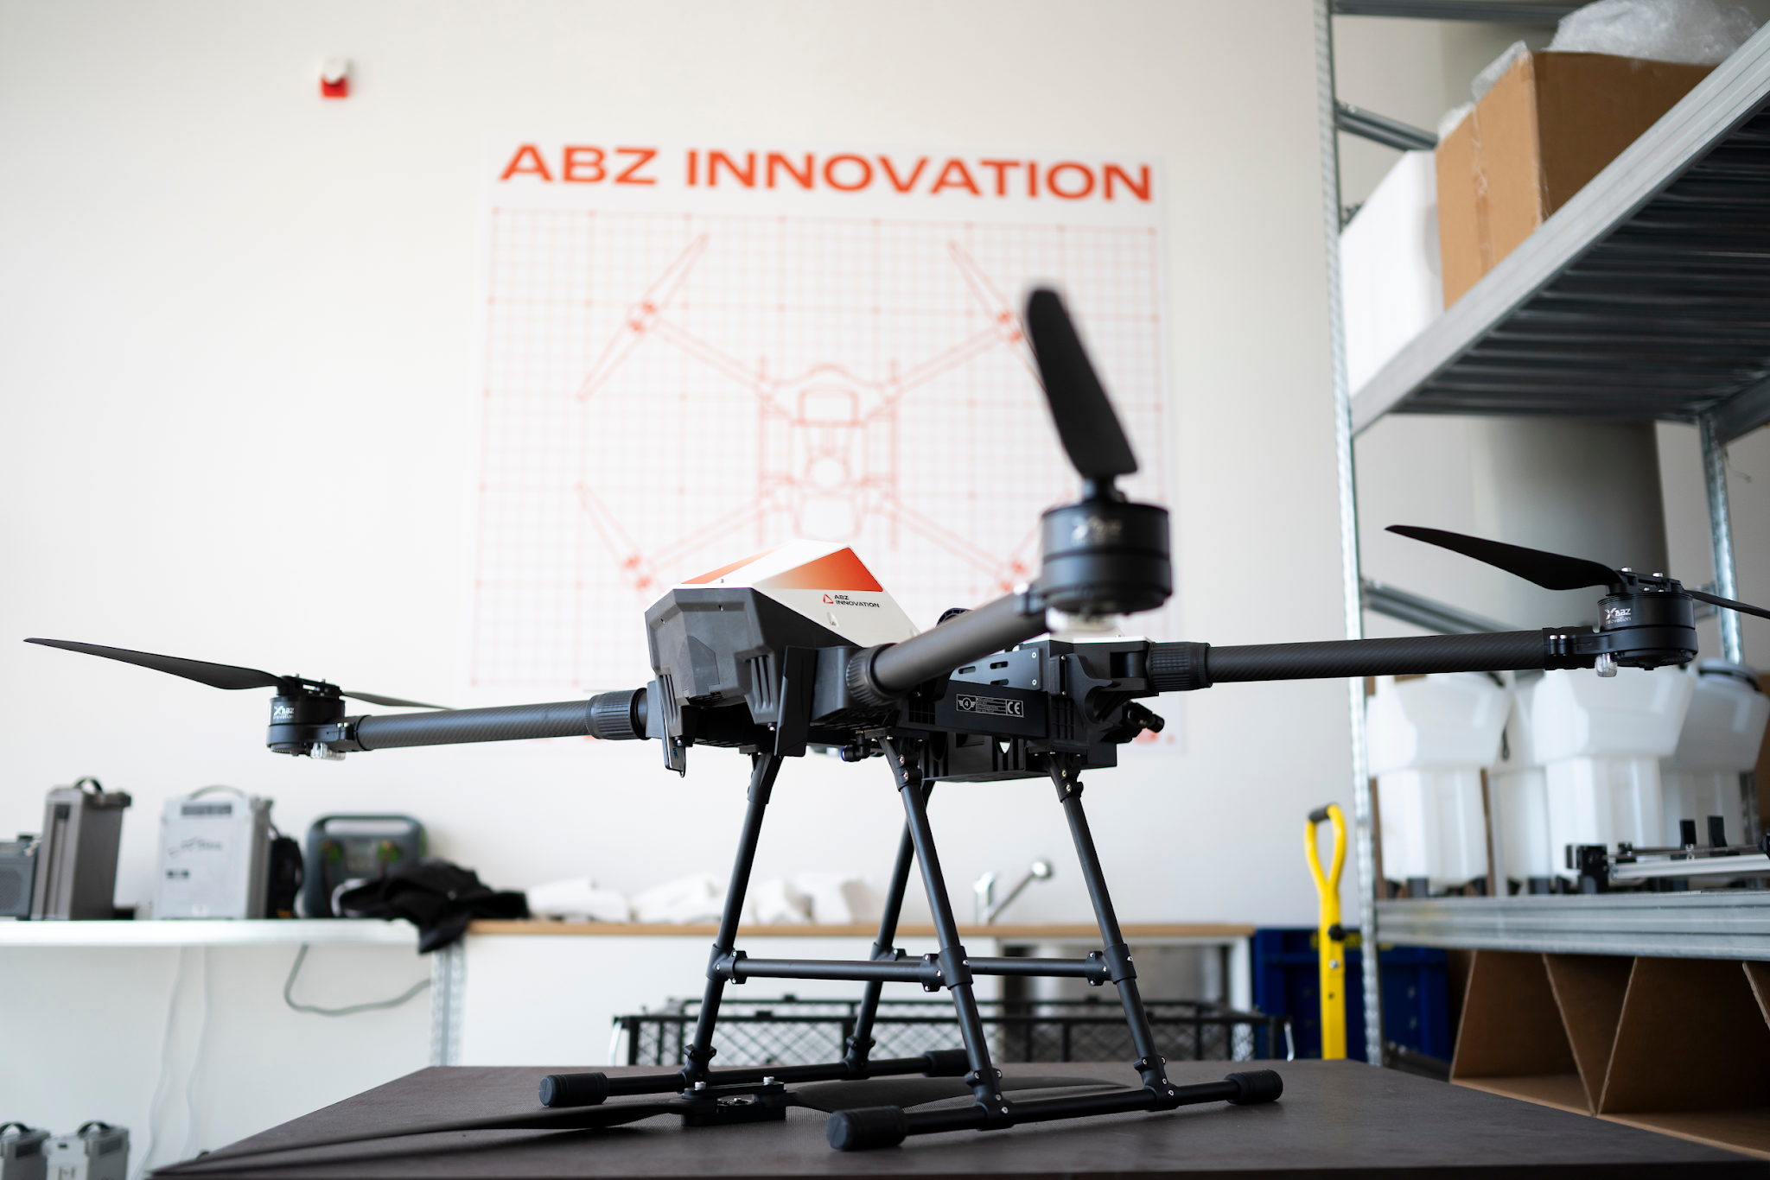
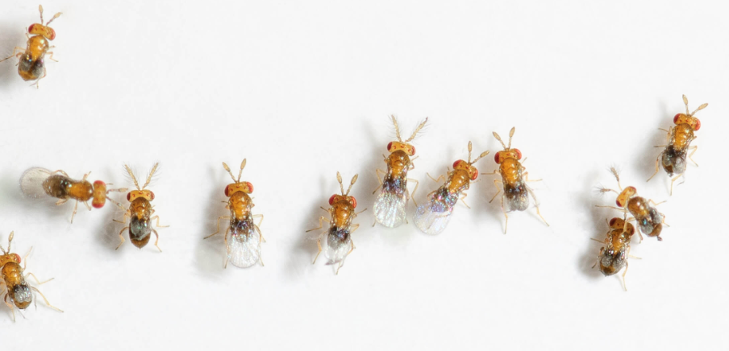
Trichogramma parasitoid
Biological
Crop Protection

Slide 2

What is Trichogramma?
Species (specific insect): Trichogramma brassicae (this is what the capsules contain)
Microscopic parasitoid wasp, size ~0.5 mm.
The female lays eggs inside pest eggs → pest larvae do not develop.
Target pests:
  European corn borer (Ostrinia nubilalis)
  Cotton bollworm (Helicoverpa armigera)

Slide 3
How these pests cause damage
Corn borer larvae: → damages corn
Start by feeding on leaves, then enter the stalk below the tassel.
  Feed downward inside the stalk, damaging vascular tissues → can disrupt nutrient transport.
  Signs: large amounts of frass (insect droppings).
Cotton bollworm larvae: → damages over 300 crops
  Feed exclusively on generative (fruit) parts, e.g., corn kernels.
  Polyphagous: also damages sunflower, tomato, pepper, peas, beans.

Slide 4
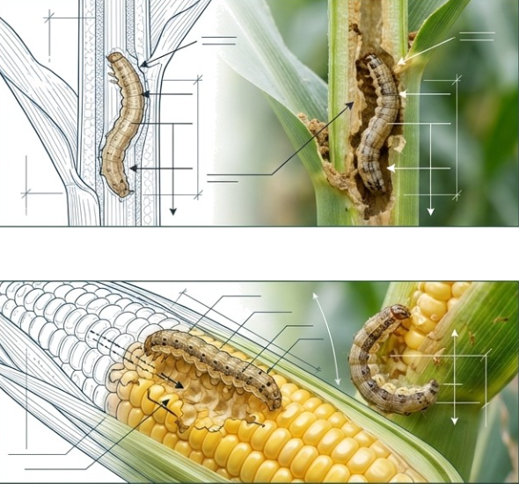

Slide 5
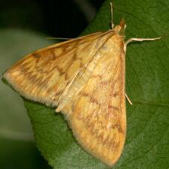
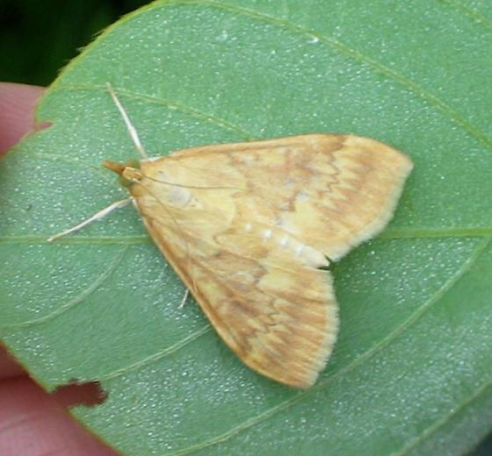
European corn borer– Ostrinia nubilalis

Slide 6
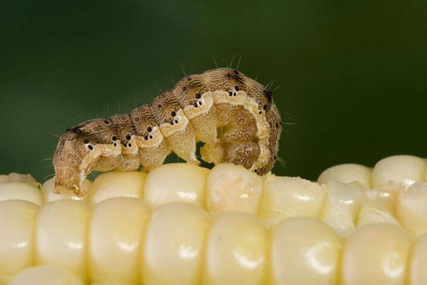
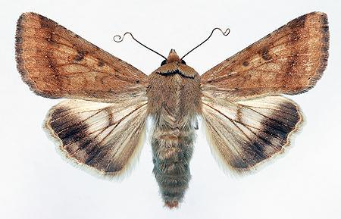
Cotton bollworm - Helicoverpa armigera
Notes:
Piszkos, okkelsárga színű, szárnyán jól kivehető a kör és vese alakú folt, a sub marginalis vonal erőteljesebb sárgásbarna.
Második pár szárnya okkelsárga színű, a külső szegélynél széles, sötétbarna sávot látunk.

Slide 7
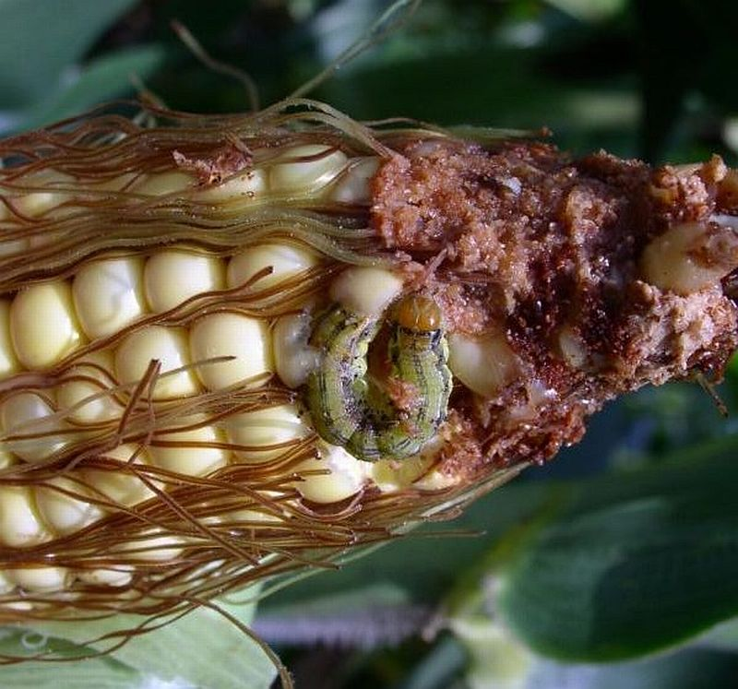
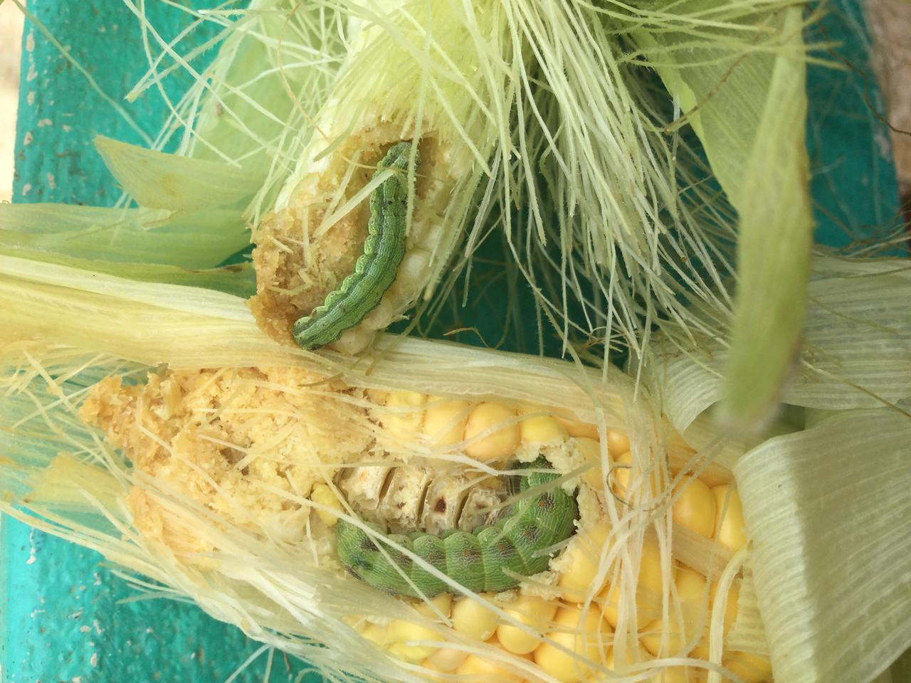
Helicoverpa armigera damage

Slide 8
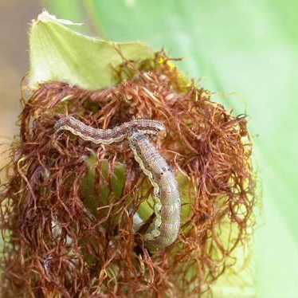
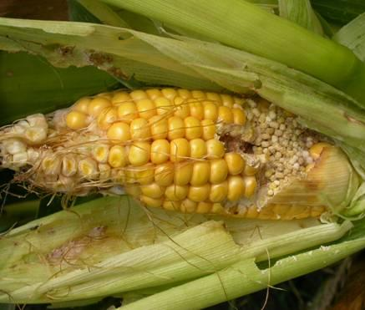
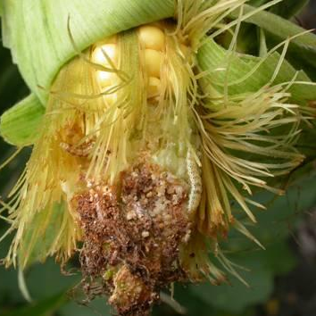
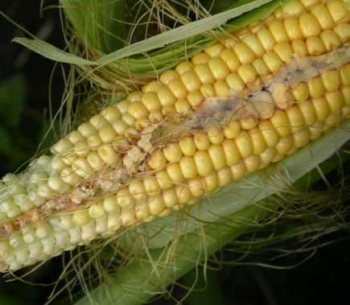
Helicoverpa armigera
larvae
Only damages the kernels

Slide 9
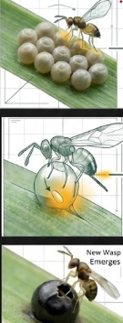
Steps of Trichogramma parasitism
Locating: The female wasp finds the pest egg using chemical signals (scent).
Inspecting: She examines the egg with her antennae to ensure it is suitable.
Oviposition: The wasp lays its egg inside the pest egg.
Hatching: The wasp egg hatches into a small wasp larva inside.
PARASITISM: The larva eats the pest egg from the inside (consuming the pest embryo)
Development: The larva develops into a full-grown wasp while still inside the eggshell.
Emergence: The fully formed, adult wasp chews its way out of the egg.

Slide 10
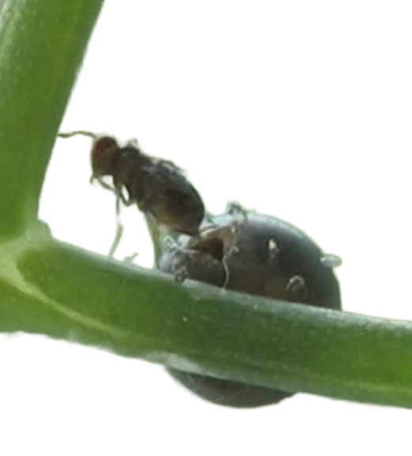
Why Trichogramma is effective and sustainable
Selective: targets only pest eggs, harmless to beneficial insects, pollinators, humans, and the environment.
No resistance risk: pests cannot adapt to parasitism.
Environment- and human-friendly: pesticide-free, improves food safety.
Cost-effective long-term: reduces chemical use, improves ecosystem health.
Most effective usage: sweet corn, seed production, sunflower

Slide 11
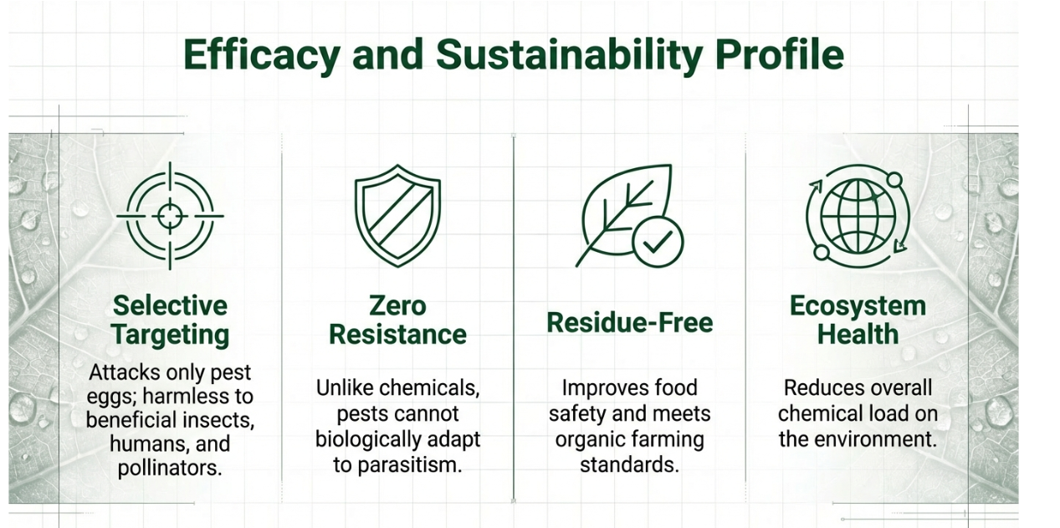


Slide 12
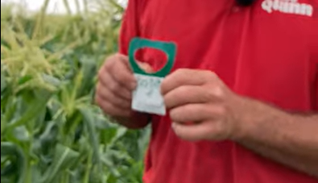
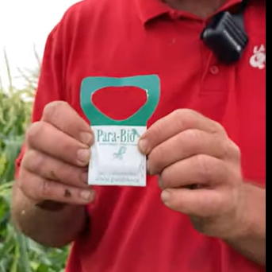
Problems with traditional Trichogramma application
Manual placement: capsules were hung or placed by hand.
Labor-intensive: required significant human effort, especially on large fields.
Uneven distribution: capsules did not always reach all plants → incomplete protection.
Limited efficiency: hard-to-reach areas often untreated.
Time-consuming: full coverage could take days, while pests continued developing.

Slide 13
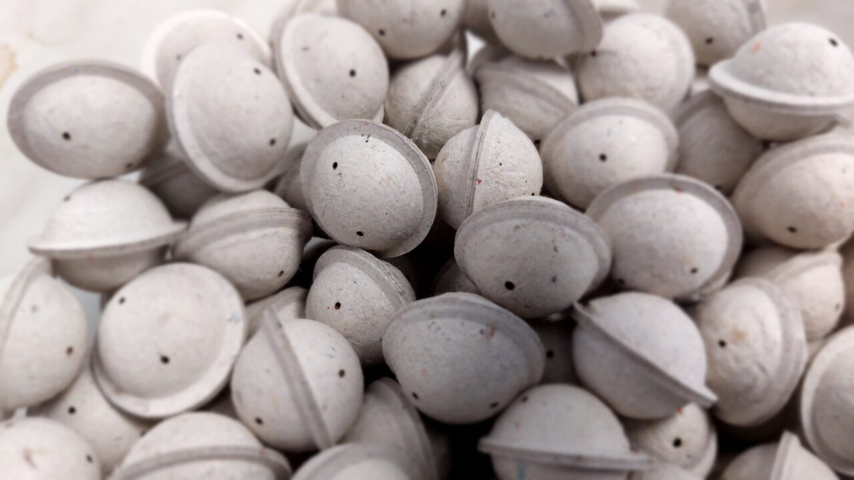
Advantages of drone-based application
Independent of soil conditions.
Can treat hard-to-reach areas.
Fast, precise, and uniform application.
Drone platforms
ABZ Innovation L10 PRO and M12:
  Designed for Trichogramma brassicae capsule deployment.
  8-liter tank capacity → carries over 300 capsules per flight.

Slide 14
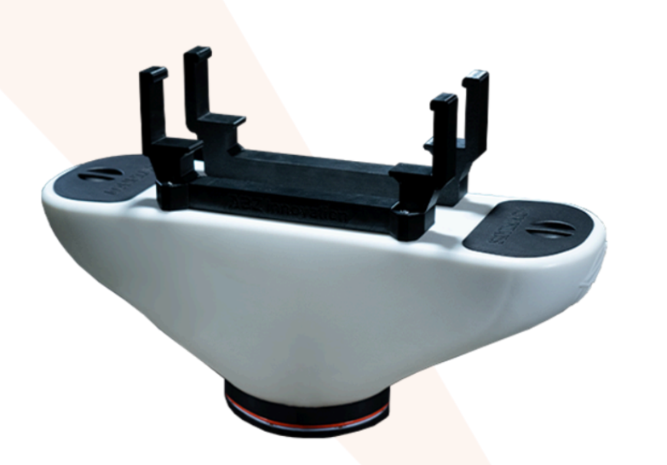
Spreader system – how it works
Polystyrene capsules containing Trichogramma are evenly distributed by a drone-mounted spreader.
Capsules fall at controlled speed and quantity, ensuring uniform coverage.
A simple open-close automatic system that releases the capsules one by one.

Slide 15
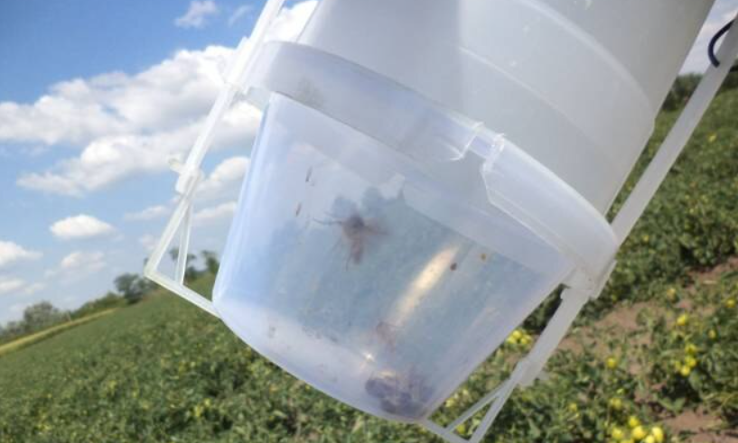
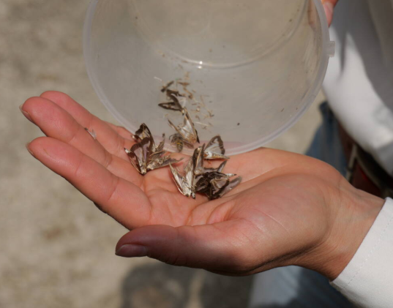
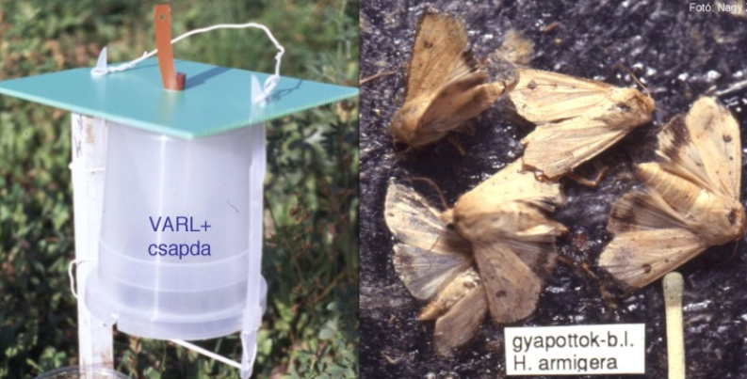
Practical tips
Timing: apply during pest peak flight (attractant trap)
Frequency: 2–3 applications, 7–14 days apart.
Weather conditions: calm, overcast or slightly cloudy, best in morning or late afternoon.
Avoid strong wind, rain, or temperatures >30°C.
Storage: keep capsules at 4–10°C, avoid direct sunlight and sudden temperature changes.

Slide 16

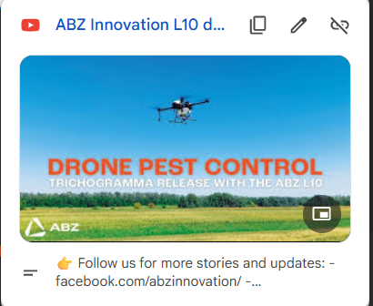
Check this out:
ABZ Innovation L10 drone releases trichogramma for early crop protection.

Slide 17
Who Needs It?
Hybrid seed corn & Sweet Corn Producers (Primary Market)
The Problem: European corn borer and Cotton bollworm cause massive damage to stalks and kernels.
Why buy? As crops grow tall, ground machinery cannot enter. Drones are the only efficient way to treat late-stage infestations without damaging the crop.
Organic & Bio Farmers
The Problem: Strict regulations forbid chemical pesticides.
Why buy? This is a 100% residue-free, natural biological solution. It meets all organic farming standards and improves food safety.

